Slide 1
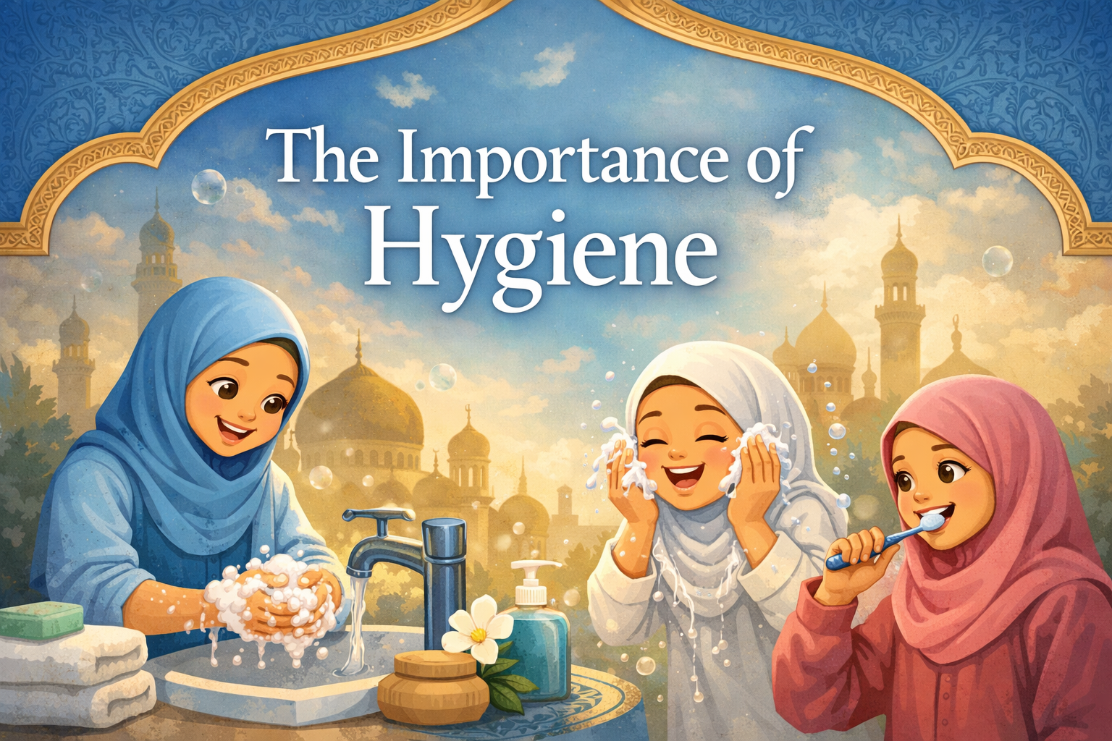


Slide 2

What is Hygiene?
Hygiene is the degree to which people keep themselves or their environment clean, especially to prevent disease. (Cambridge Dictionary)
Hygiene is a set of practices performed to preserve health.
According to the World Health Organization (WHO), "Hygiene refers to conditions and practices that help to maintain health and prevent the spread of diseases.
Personal hygiene refers to maintaining the body's cleanliness.
Hygiene activities can be grouped into the following: home and everyday hygiene, personal hygiene, medical hygiene, sleep hygiene, and food hygiene. (Wikipedia)

Slide 3

Allah says in the Holy Quran:
“Allah loves those who turn to Him and loves those who keep themselves clean.’ (2:223)
This means that if we want to make Allah happy and
we want Him to love us, we have to listen to His
Commandments; in this case the commandment
of keeping ourselves clean and pure.

Slide 4

The Holy Prophet^{(pbuh)} said:
“Cleanliness is half of faith.” (Sahih Muslim)
This Hadith emphasizes the importance of Hygiene in Islam.
Physical hygiene/cleanliness is just as important as spiritual purity; physical purity has a deep connection with spiritual purity.

Slide 5

Why does Allah want us to keep clean?
One could truly gain Divine closeness when one develops apparent/physical as well as spiritual purity; apparent purity and cleanliness sustains inner purity.
Islam enjoins taking a bath at the very least each Friday and ablution before each Salat and endorses using perfume before going to mosque or large gatherings.
The reason for this is to create a peaceful and cooperative atmosphere.
(Hazrat Khalifat-ul-Massih V, Friday Sermon April 23, 2004;
https://www.alislam.org/friday-sermon/2004-04-23.html)
Hygiene/cleanliness is important for our relationship
with Allah, as well as with people!

Slide 6
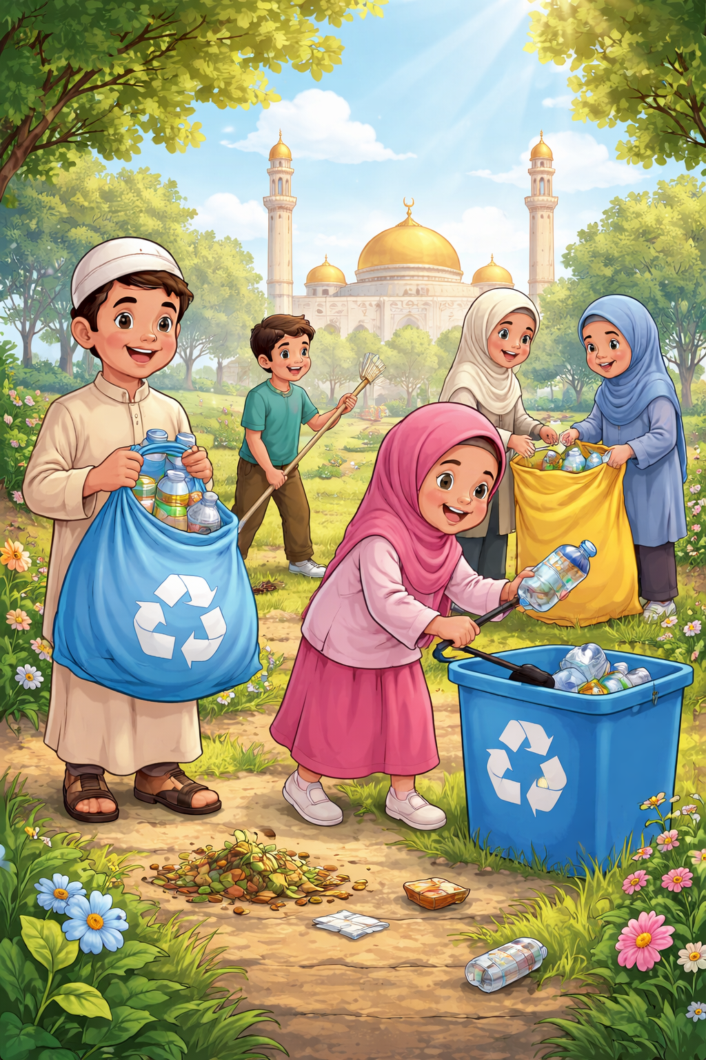
The Holy Prophet^{(pbuh)} would personally remove any stone, twig or any other obstacle blocking the path and enjoined others to do so, too.
→ So it is important to not only keep ourselves clean, but also our surroundings:
our room
our bathroom
our house
our garden
our community
our car
our classroom
our Masjid
……..

Slide 7

VIDEO: All About Hygiene

Slide 8
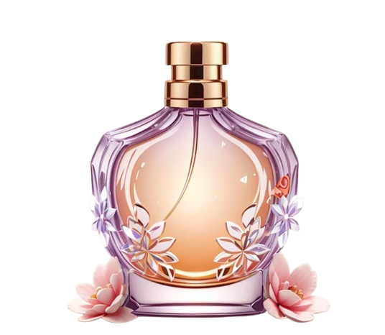
Fun Fact
The Holy Prophet^{(pbuh)} said that when a friend gives perfume as a gift, one should accept it and indeed use it.
The Holy Prophet^{(pbuh)} himself would
carry a very beautiful fragrance, the
smell of which lingered on the pathways
that he had passed.
(Hazrat Khalifat-ul-Massih V, Friday Sermon April 23, 2004;
https://www.alislam.org/friday-sermon/2004-04-23.html)

Slide 9
Resouces:
https://dictionary.cambridge.org/dictionary/english/hygiene
https://en.wikipedia.org/wiki/Hygiene
https://alislam.org/quran/app/2:223
https://www.alislam.org/friday-sermon/2004-04-23.html
https://www.youtube.com/watch?v=01COSszay_g
https://img.favpng.com/14/16/20/symbol-hygiene-hand-washing-sign-png-favpng-kmw4NLyik0bMw1LZqS1PVRDVy.jpg
https://img.freepik.com/premium-photo/perfume-cartoon-vector-icon-illustration-fashion-object-icon-concept-isolated-premium-vector-flat-cartoon-style_1033579-23982.jpg

